Slide 1

NEWS PORTAL
Presented By:
ROHIT AGRAWAL
PRAJWOL THAPA
SALIN DEV NAKARMI
NABIN SHAHI
Parameshwor rokaha
Deep kumar maharjan

Slide 2
INTRODUCTION
Developed for the purpose of providing news to all viewers.
User satisfaction related news will be published.
Developed using django

Slide 3
OBJECTIVES
Develop a dynamic website for online news portal system full of relevant information and easy to use.
Supplying with news according to user ‘s priority
Providing as possible accurate news from multiple sources.

Slide 4
LITERATURE REVIEW
Online khabar
eKantipur
Nagarik news

Slide 5
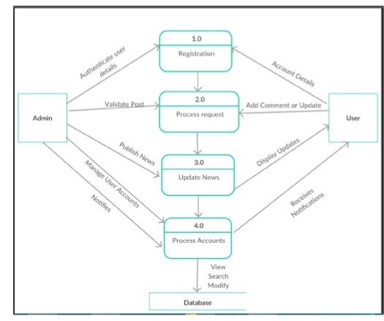
Data Flow Diagram

Slide 6
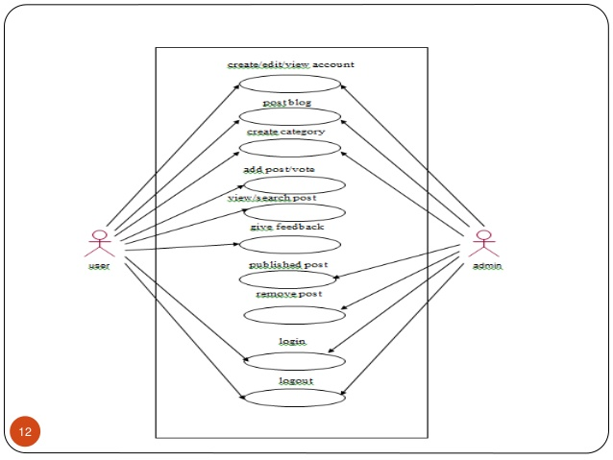
Use Case Diagram

Slide 7
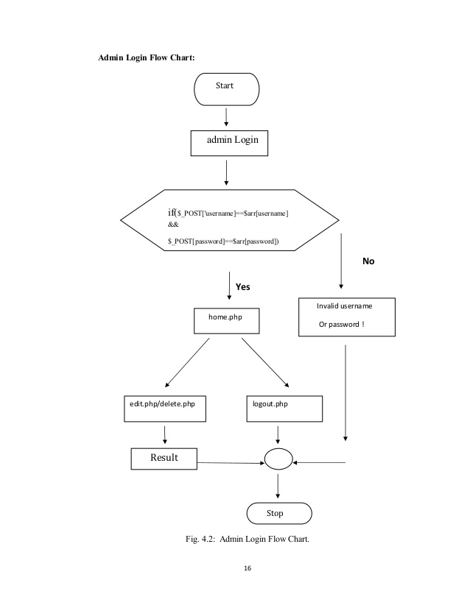
Block Diagram

Slide 8
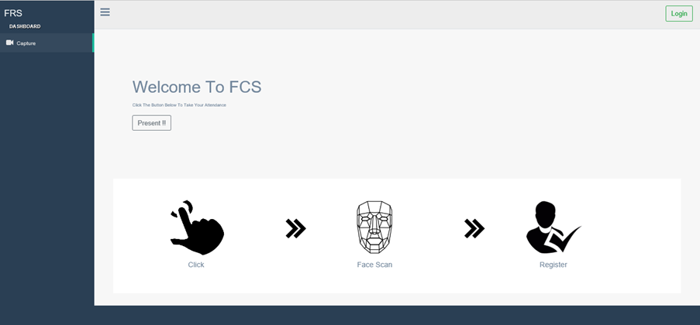
Frontend Works

Slide 9
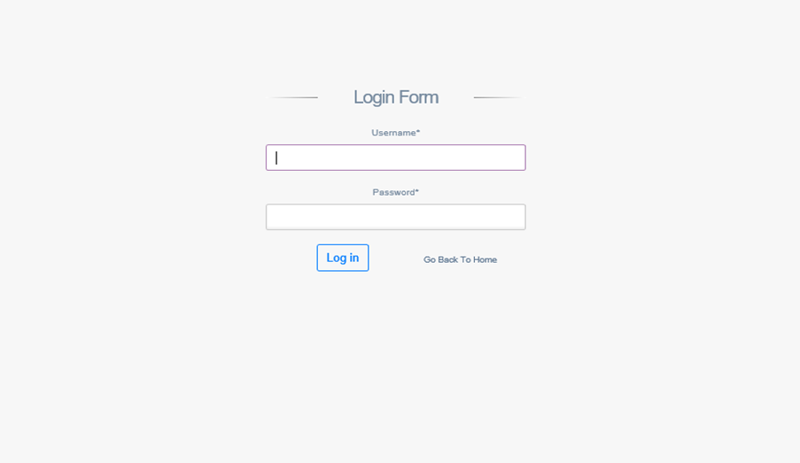
Login Interface

Slide 10
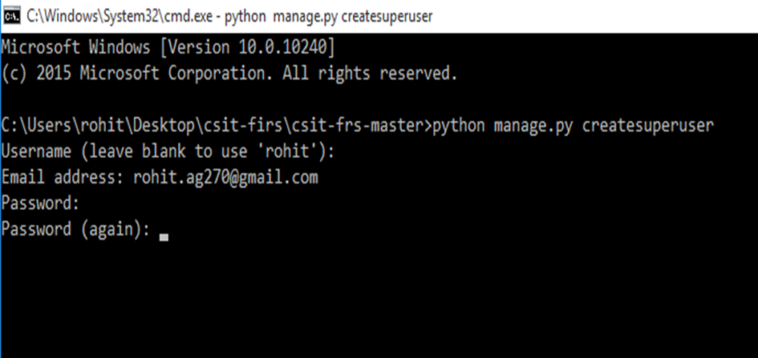
Creating a Admin from Command Prompt

Slide 11
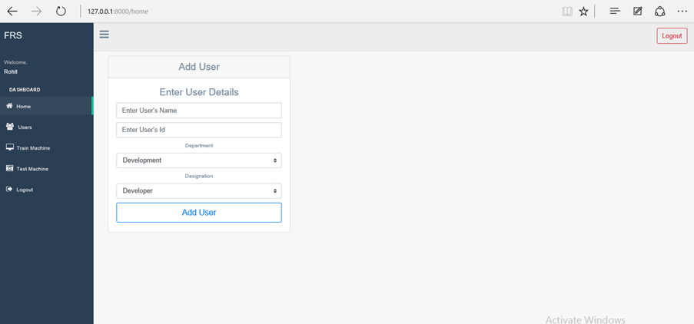
Adding a New User

Slide 12
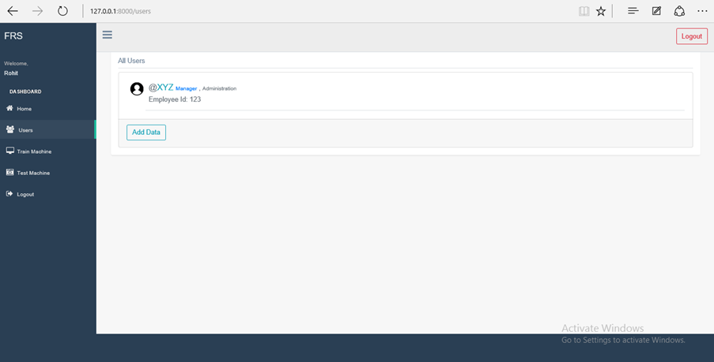

Slide 13
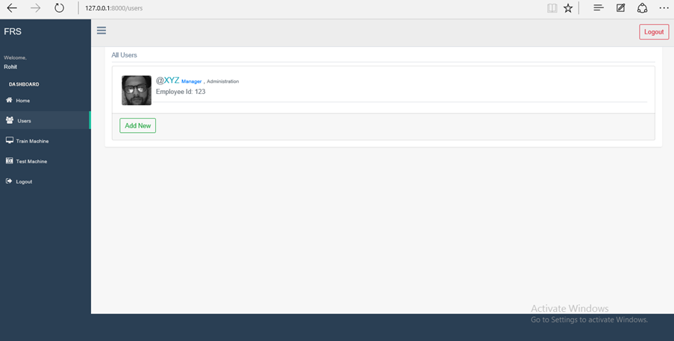
Adding Face Data

Slide 14



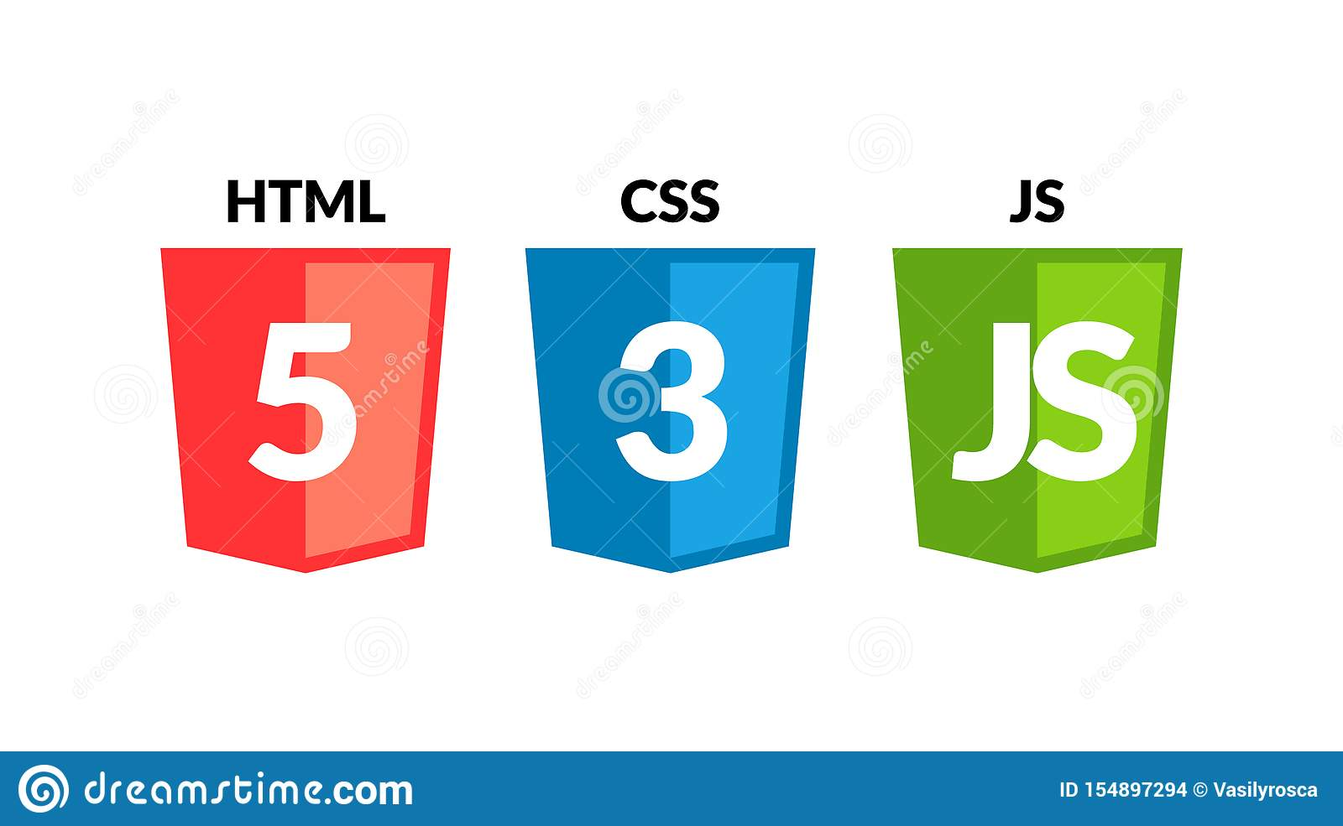
Tools Used
Front-End
Back-End
Database

Slide 15
ANY QUERIES???

Slide 16
Thank You

